Slide 1
DIGITAL LEARNING GAP IN COVID-19
By Tram Vu, Nam Nguyen & Anh Bui

Slide 2



Hi! Meet the Team
Nam Nguyen
Tram Vu
Anh Bui

Slide 3
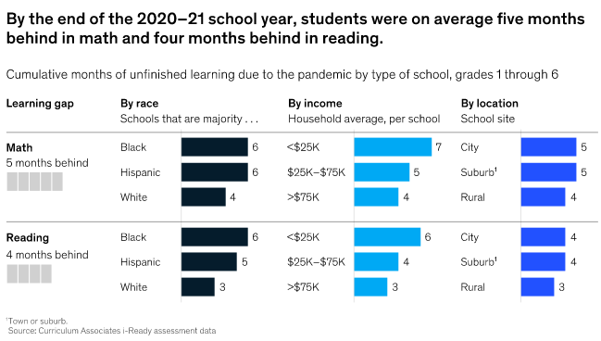
Black is already behind in learning .
And now the gap is even bigger after Covid-19
Sources: McKinsey, 2022, COVID-19 and learning loss—disparities grow and students need help

Slide 4
BIG QUESTION
Why education gap between Black & White grows bigger?

Slide 5

DIGITAL LEARNING OVERVIEW
Based on :
Access
(% student access page)
Engagement Index
(number of page load)
Product Use
Looking through:
By Black/White student group
By Locale
By Economic Condition
By Top product used

Slide 6
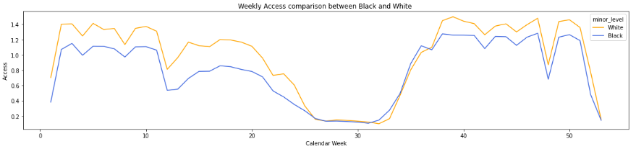
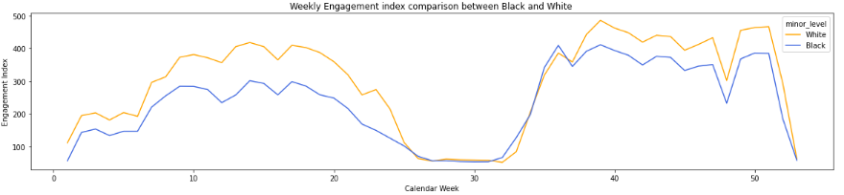
Blacks have lower access and engagement
than its White peers.

Slide 7
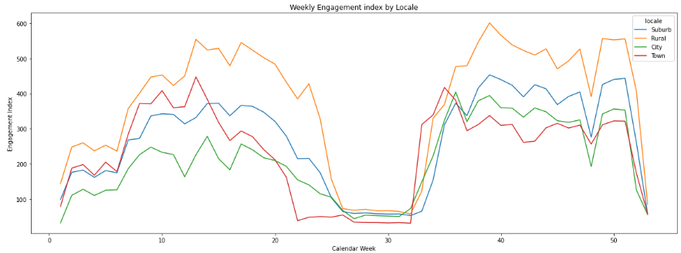
The more we move away from the urban context, the higher the levels of digital engagement
Notes:
Ve them hinh nhu vach song wifi the hien urban context

Slide 8
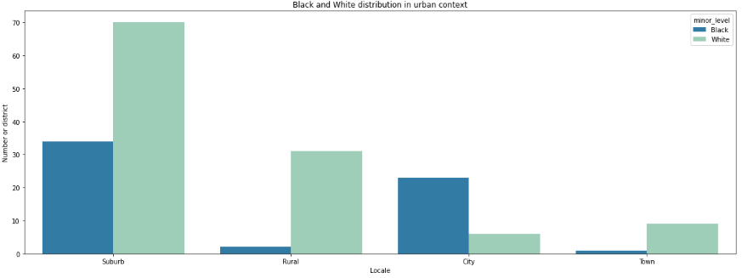
White lives in all locations whereas
Black lives only in City and Suburbs

Slide 9
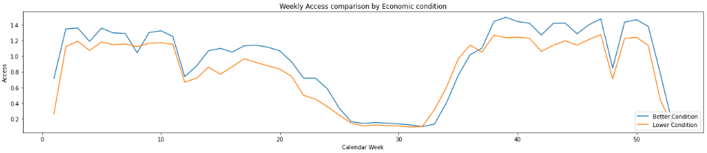
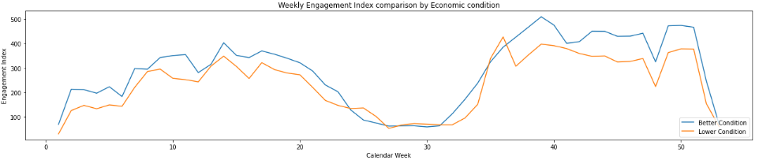
Students with better Economic condition
have higher access, and so does engagement index
*Note: If students are eligible for free lunch, they are more likely under worse economic condition.
Notes:
Access theo free lunch và màu da, đổi màu da trắng màu xanh da đen màu đỏ

Slide 10
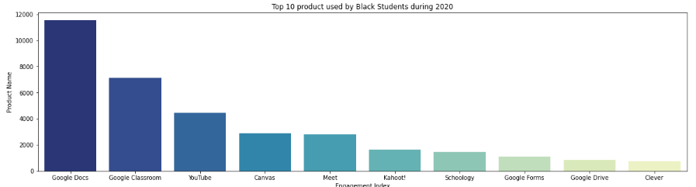
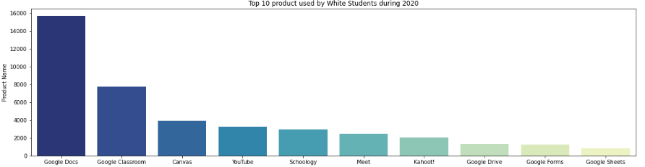
Students used similar Digital Learning Product
Top products:
Google Docs
Google Classroom
Youtube
Canvas
Schoology
Kahoot!
Meet

Slide 11
So What affects Access and Engagement?
Introduce No Internet Connection, No computer and Depression.

Slide 12
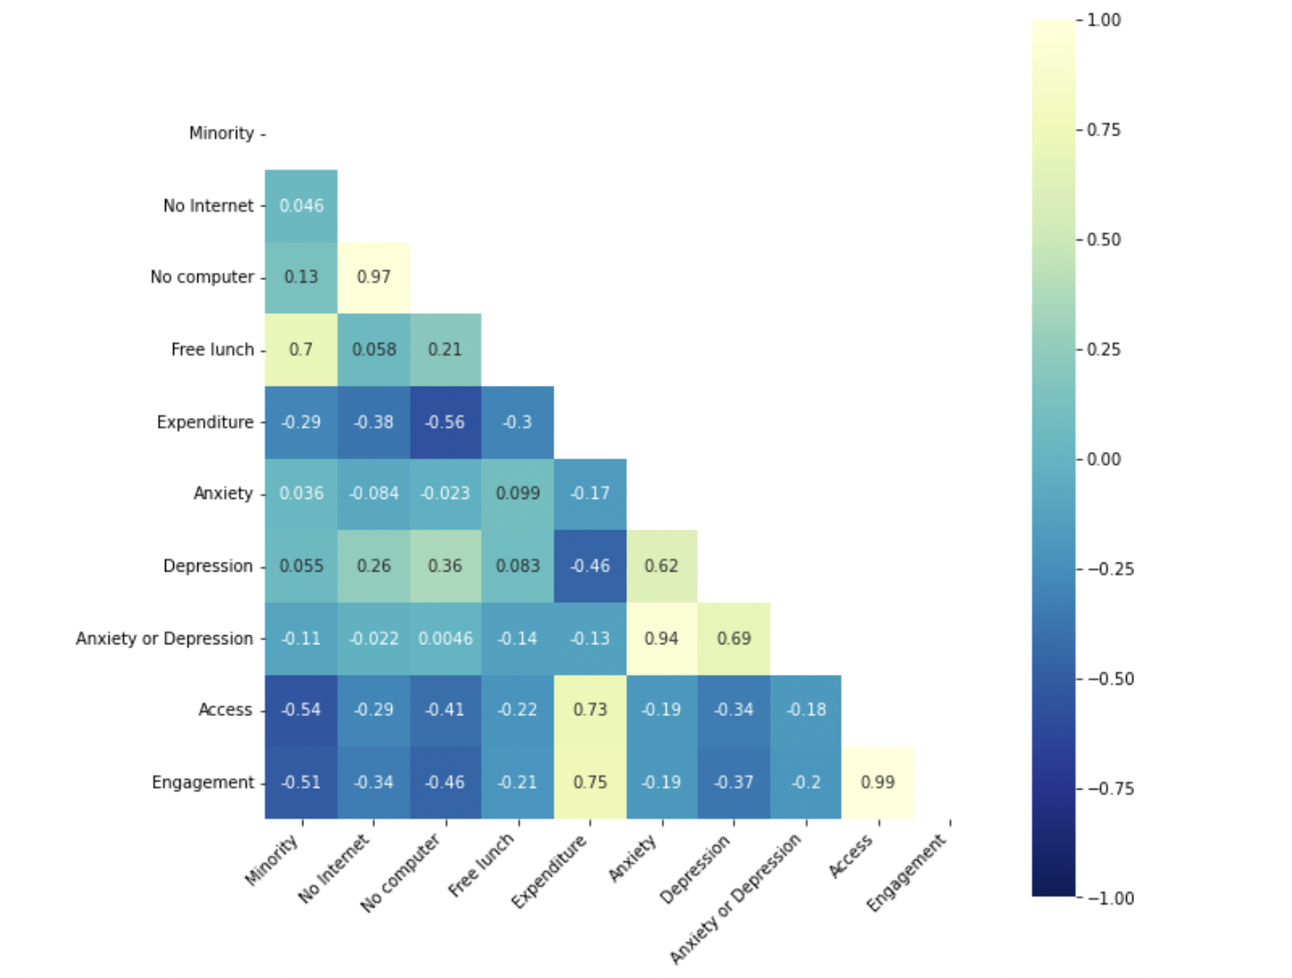
Factors correlate to Engagement and Access
Expenditures
No INTERNET
No COMPUTER
Depression
Notes:
Loneliness, fear of infection, suffering and death for oneself and for loved ones, grief after bereavement and financial worries have also all been cited as stressors leading to anxiety and depression.

Slide 13
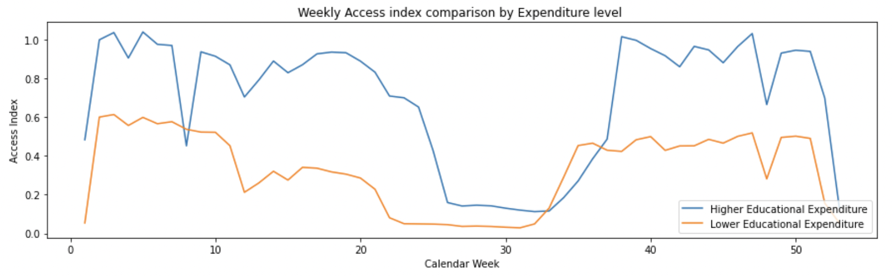
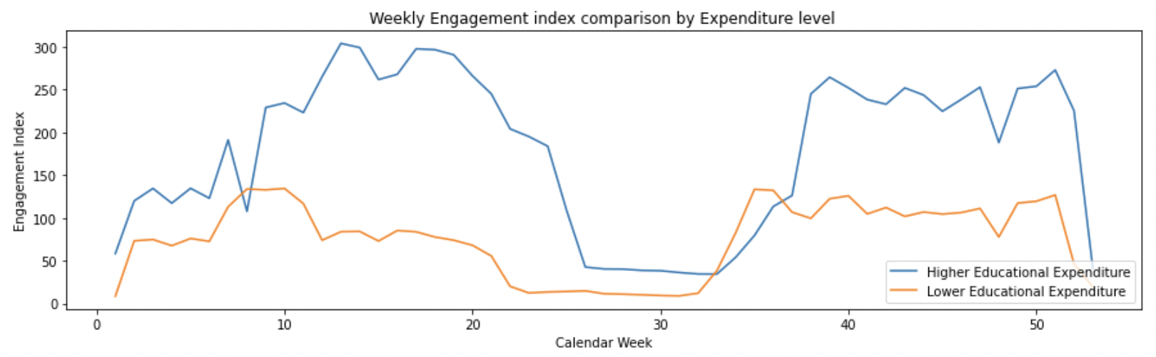
Larger expenditures does translate to HIGHER access and engagement
1.

Slide 14
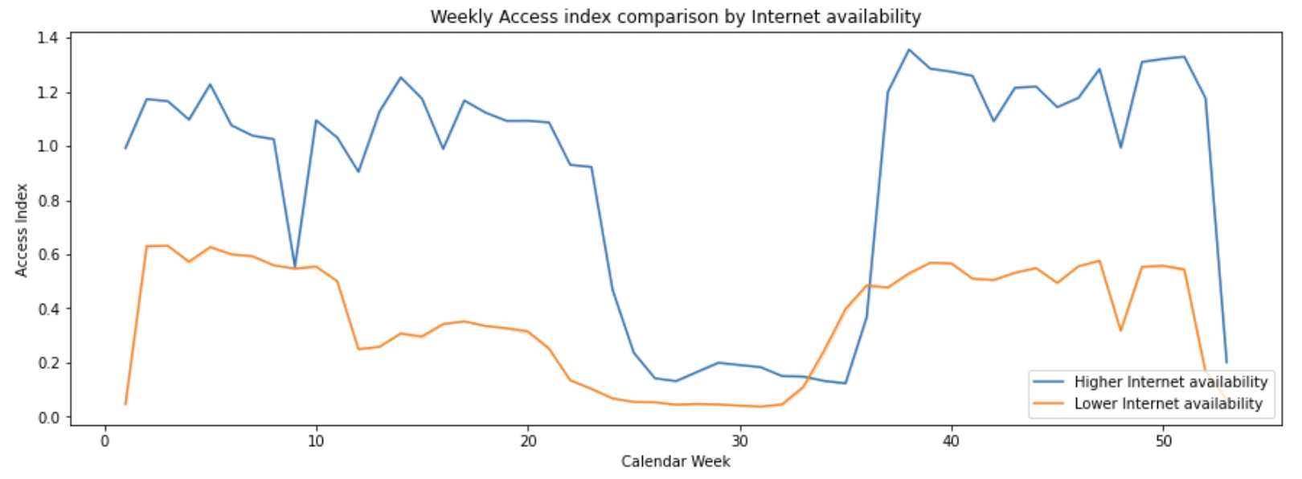
Access is affected by Internet Connection
2.
*Note: Internet availability referred to households having internet connection by State
Notes:
Engagement -> performance nhung da den chet o phan dau vao access. Them stt de theo doi va de nam luan diem

Slide 15
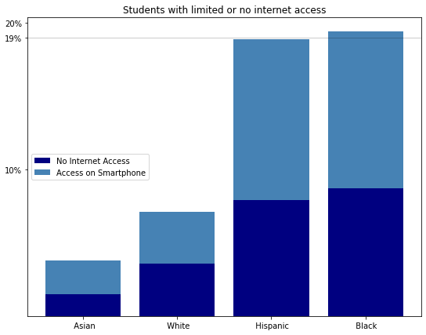
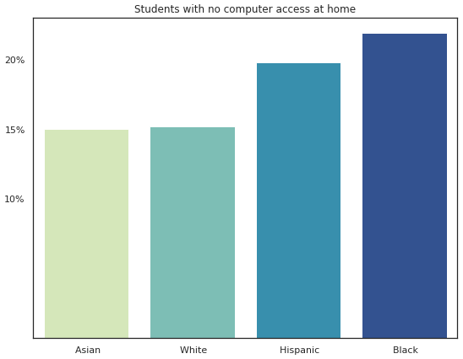
Black students has limited Computer and Internet Access
Notes:
Khong co hoc dc onl thi ko access dc not only lesson missed but also teachers-instruction miss;

Slide 16
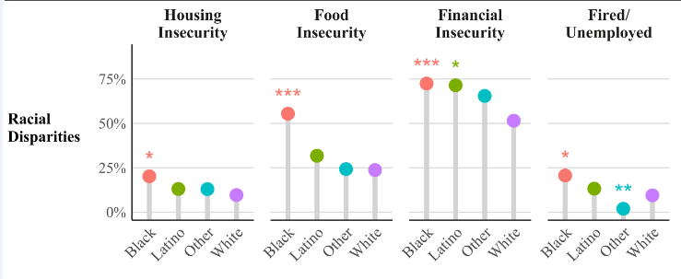
Blacks does not feel secure during Covid-19
3.
Source: PNAS, 2021, Pandemic precarity: COVID-19 is exposing and exacerbating inequalities in the American heartland,

Slide 17
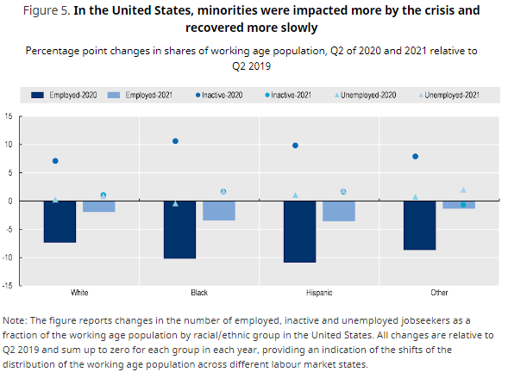
Blacks were impacted more by crisis

Slide 18
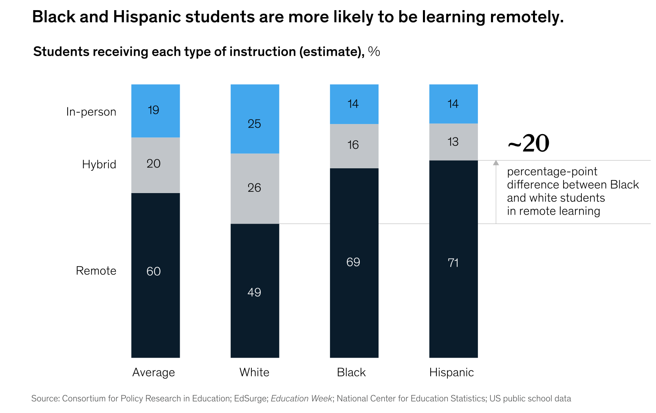
MORE Remote Learning for Black
20% higher in Remote Learning
20% higher in Remote Learning
“They are less likely want their children to attend in-person classes”
(McKinsey, 2022)
“69% Black have to learn remotely.”
“Black are under-average In-person Instruction”
Source: McKinsey, 2022, COVID-19 and learning loss—disparities grow and students need help

Slide 19
DISCUSSION:
Reason WHY the gap grows bigger?
Limited Internet and Computer lead to limited access
WIFI- COMPUTER
ACCESS
Depression prolongs Remote learning
MENTAL HEALTH
ENGAGEMENT
BIGGER EDUCATIONAL GAP

Slide 20
DISCUSSION:
HOW to not make the gap even grow bigger?
Expenditure
WIFI- COMPUTER
ACCESS
MENTAL HEALTH
ENGAGEMENT
BETTER DIGITAL LEARNING

Slide 21
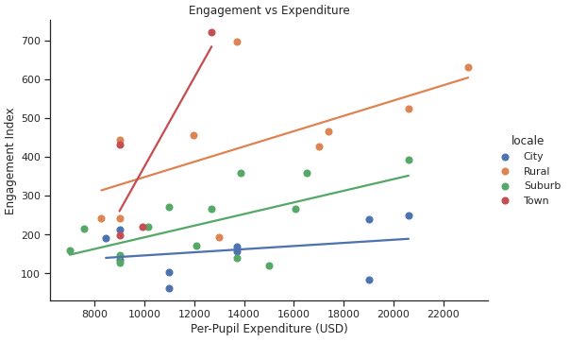
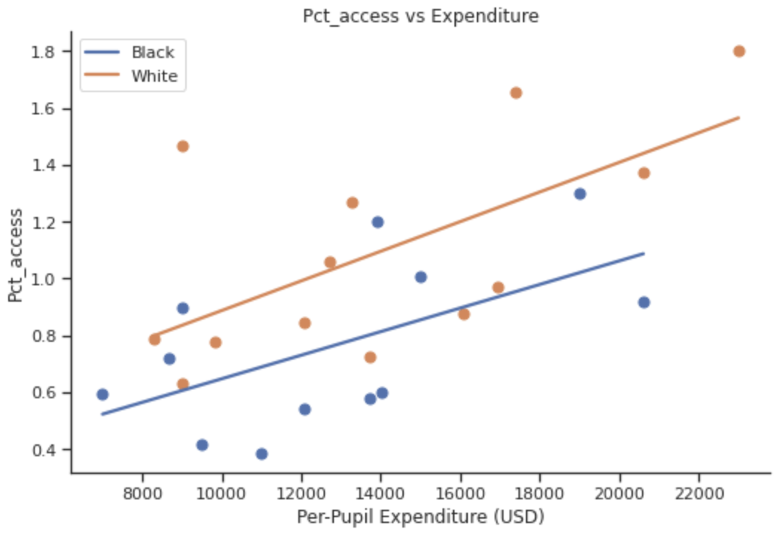
Where to focus on educational expenditure?
Expenditure pays for
Faculty Salaries
Financial aid
Campus construction and upgrades
Transportation services
School supplies (computers)
Expenditure focused

Slide 22
Focus on Education &
Solve Digital Learning
basic needs
Expenditures for Education reflect the level of Education-oriented.
Less education-oriented State should review their expenditures, reallocate funds and help its students by investing in their basic needs.

Slide 23
References
McKinsey, 2022, COVID-19 and learning loss—disparities grow and students need help
https://www.mckinsey.com/industries/public-and-social-sector/our-insights/covid-19-and-learning-loss-disparities-grow-and-students-need-help?fbclid=IwAR208dJcNPD9YqAHSm_hdquu1CmDNOV77aQ99fqJGX7ZYdpLKXI-2_Plzj8
KFF, 2022, Black, Hispanic, and Low-Income Workers are Much Less Likely to Feel ‘Very Safe’ at Work, KAISER FAMILY FOUNDATION
https://www.kff.org/coronavirus-covid-19/?fbclid=IwAR3cSex_Tp3JcFdkpW1GIyfJVtjm9DcVvttw0IfWKwt87b9OqKMhoJ49NYQ
WHO, 2022, COVID-19 pandemic triggers 25% increase in prevalence of anxiety and depression worldwide, World Health Organization.
https://www.who.int/news/item/02-03-2022-covid-19-pandemic-triggers-25-increase-in-prevalence-of-anxiety-and-depression-worldwide

Slide 24
References
OECD, 2022, The unequal impact of COVID-19: A spotlight on frontline workers, migrants and racial/ethnic minorities, Organisation for Economic Co-operation and Development
https://www.oecd.org/coronavirus/policy-responses/the-unequal-impact-of-covid-19-a-spotlight-on-frontline-workers-migrants-and-racial-ethnic-minorities-f36e931e/
NCES, 2020, Children’s Internet Access at Home (Table 702.12 & Tabel 702.40)
https://nces.ed.gov/programs/coe/indicator/cch
PNAS, 2021, Pandemic precarity: COVID-19 is exposing and exacerbating inequalities in the American heartland, Proceedings of National Academy of Sciences of USA
https://www.pnas.org/doi/10.1073/pnas.2020685118#bibliography
KFF, 2022, Adults Reporting Symptoms of Anxiety or Depressive Disorder During COVID-19 Pandemic, KAISER FAMILY FOUNDATION
https://www.kff.org/other/state-indicator/adults-reporting-symptoms-of-anxiety-or-depressive-disorder-during-covid-19-pandemic/?currentTimeframe=0&sortModel=%7B%22colId%22:%22Location%22,%22sort%22:%22asc%22%7D

Slide 25
THANKS!
Any questions?

Slide 26
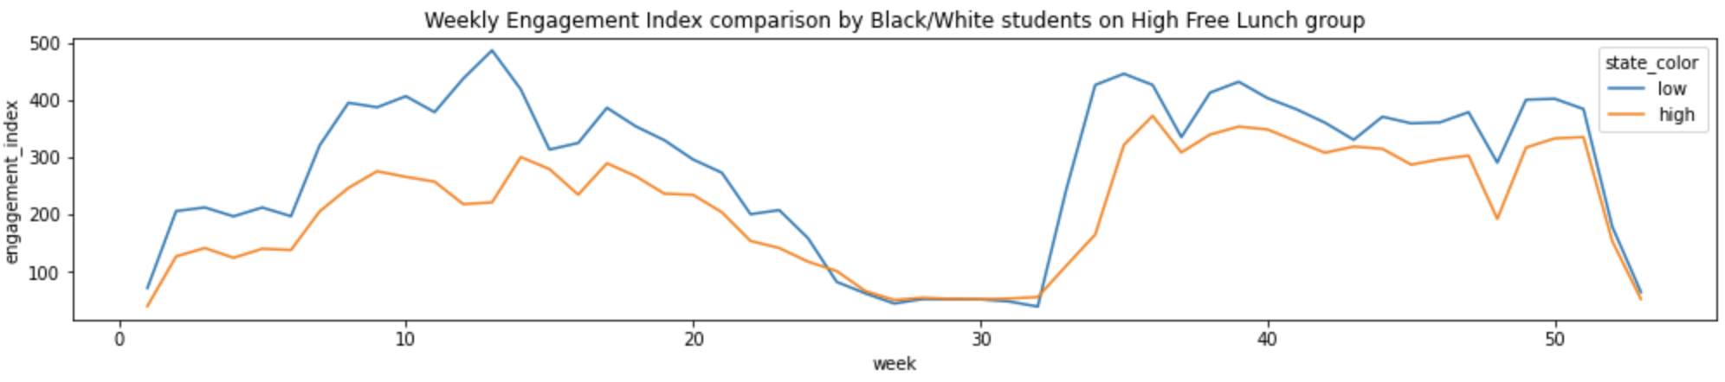
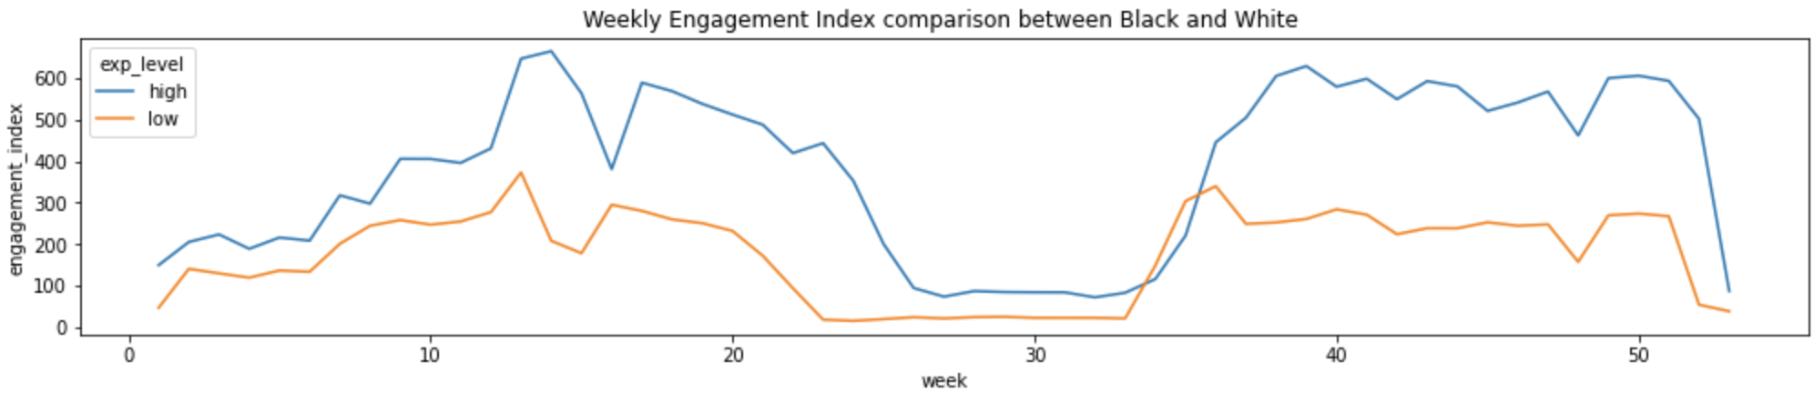
But in same economic status, Blacks have lower access and engagement

Slide 27
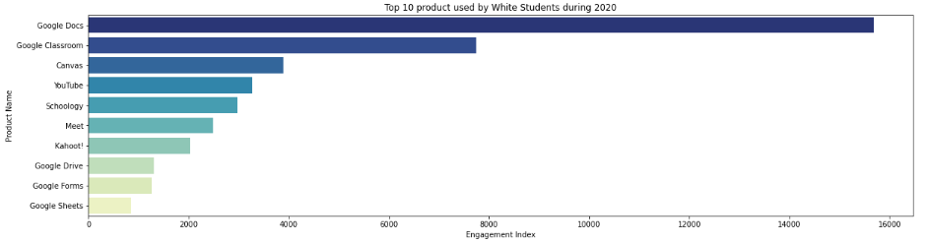
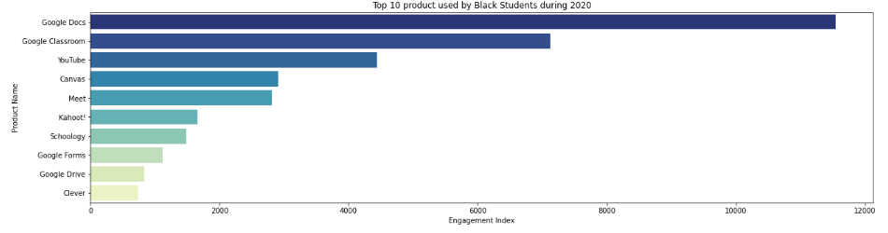

Slide 28
COVID-19 triggers depression and highlighted disparities between ethnics.
COVID-19 pandemic triggers 25% increase in prevalence of anxiety and depression worldwide (WHO, 2022).
Loneliness, fear of infection, suffering and death for oneself and for loved ones, grief after bereavement and financial worries have also all been cited as stressors leading to anxiety and depression.
Minority workers were more likely to lose their employment than white workers in the same industries and occupations (OECD, 2022)
Blacks and Hispanics are lagging behind in the recovery (OECD, 2022)

Slide 29
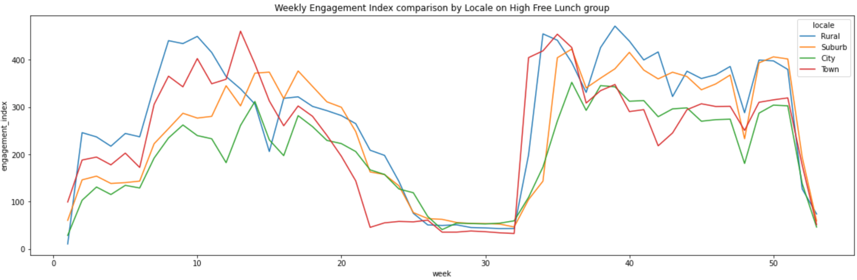
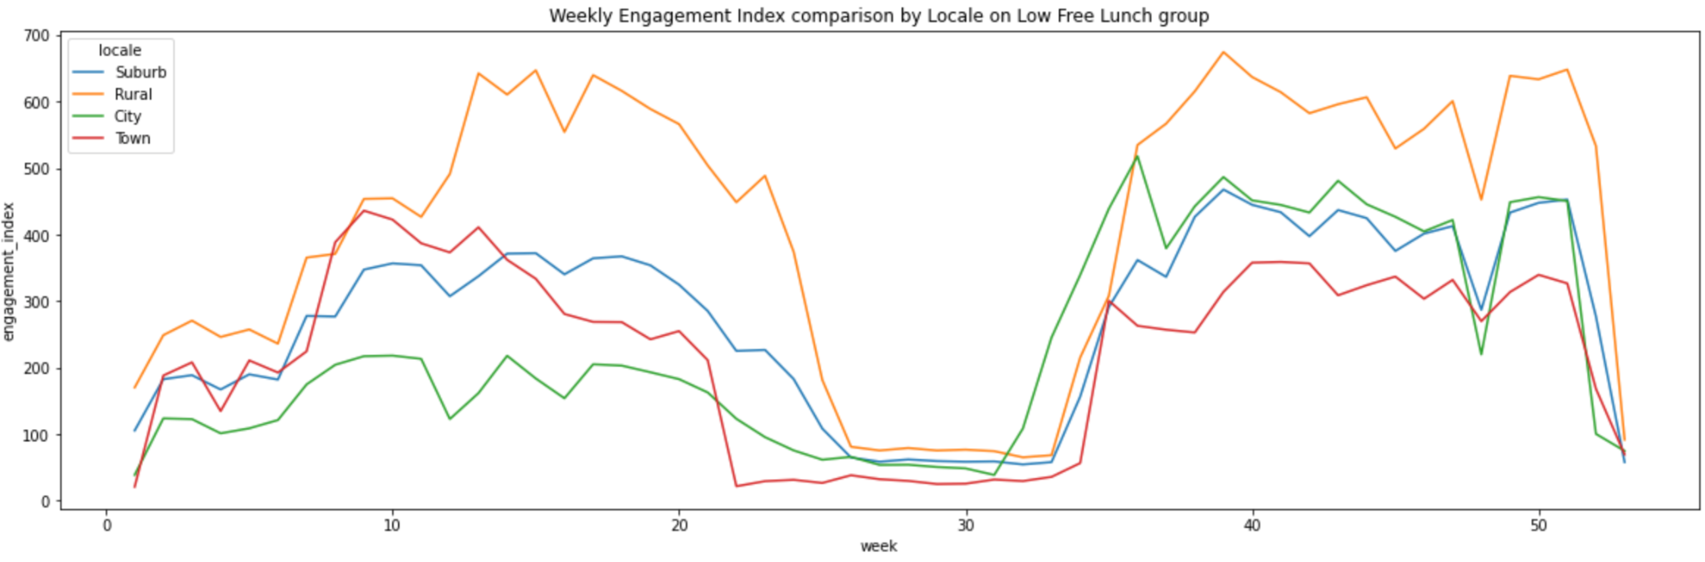
Trong cung dieu kien high -free lunch ngheo, black luc nao cung co engagement thap hon

Slide 30
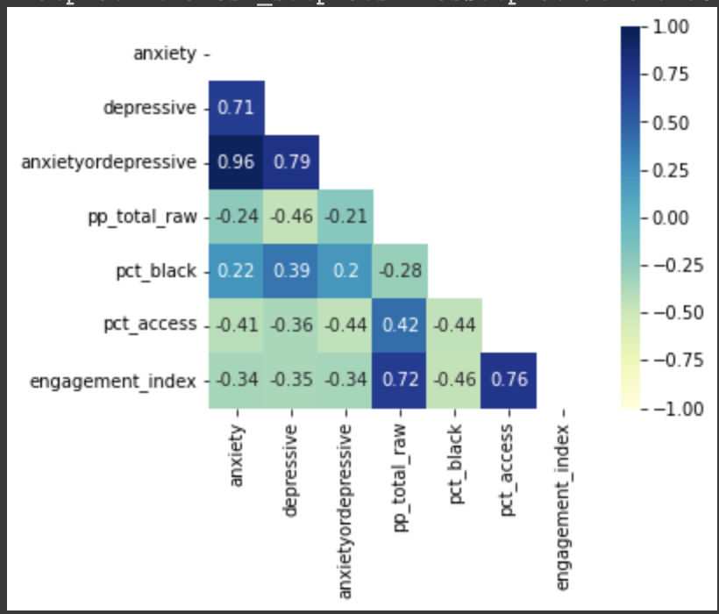
Anxiety and Depression from Covid-19 do affect Access and Engagement

Slide 31
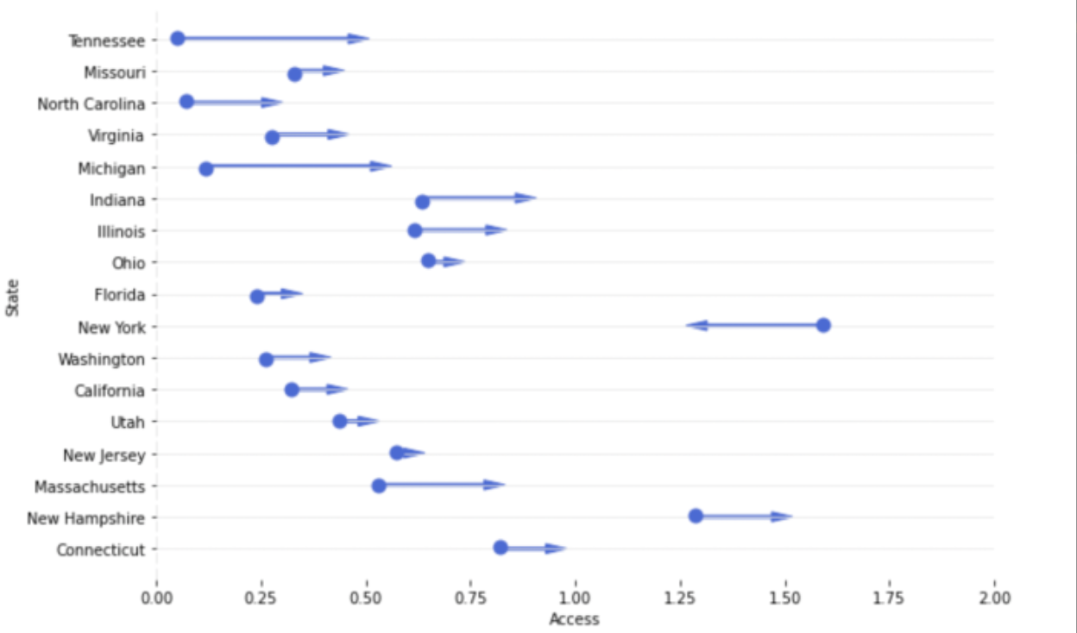
Conditions for learning have improved significantly since the spring
ABCNews, 2022, NYC mayor considering virtual learning plan for schools
https://abcnews.go.com/Health/wireStory/reversal-nyc-mayor-remote-option-schools-82248518?fbclid=IwAR2nDLptVii2y6D8k7ozy42CcA7n-vcZlk-ed5u3ChDiGpCEiJJrQ7J1DQE
“New York was one of the first to return to in-person instruction after the pandemic hit in 2020. They started a hybrid plan in the fall of 2020”
( ABCNews, 2022)

